Slide 1
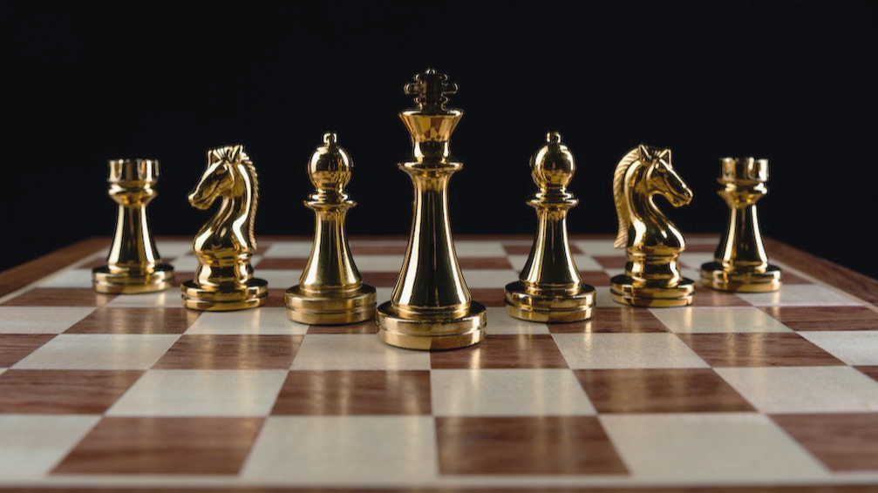
CHESS
CIS 434 SOFTWARE ENGINEERING
GROUP 6

Slide 2
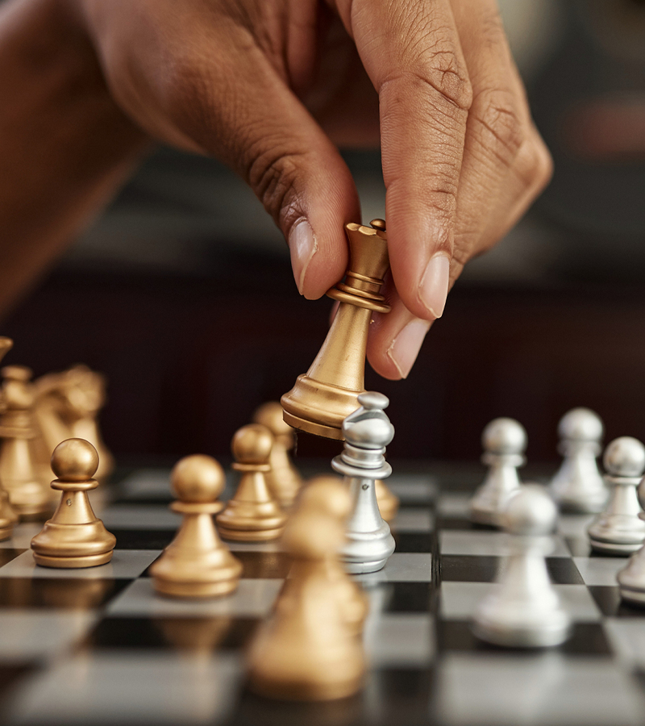
Abstract
Chess is an abstract strategy board game for two players
Chess is a challenge and an engaging and challenging game that provides a fun and educational experience for players of all levels
Python Chess is a chess game built with Python that provides a graphical user interface that allows players to play against the computer or against other players over a network.

Slide 3
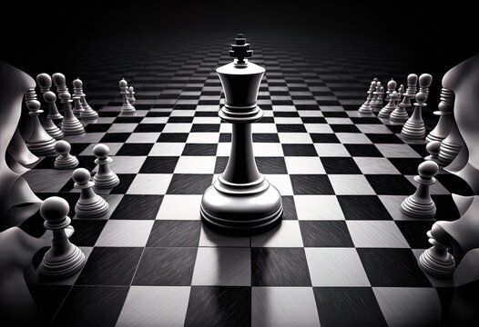
Introduction and Background
Invented in China around 200 B.C by commander Han Xin
Played on a chess board with 64 squares
Each player controls sixteen pieces, one king, one queen, two rooks, two bishops, two knights, and eight pawns
To win the game, the player needs to checkmate the opponent's king whereby there is no way for the king to escape

Slide 4
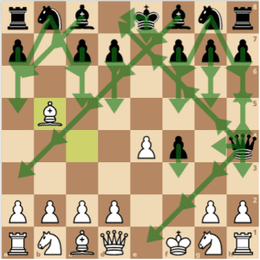
Introduction and Background
This shows the movement restrictions of the King during a game.
King
Queen
Bishop
Knight
Rook
Pawn
Notes:
The king moves one square in any direction. There is also a special move called castling that involves moving the king and a rook. The king is the most valuable piece—attacks on the king must be immediately countered, and if this is impossible, the game is immediately lost• A rook can move any number of squares along a rank or file, but cannot leap over other pieces. Along with the king, a rook is involved during the king's
A bishop can move any number of squares diagonally, but cannot leap over other pieces.
A queen combines the power of a rook and bishop and can move any number of squares along a rank, file, or diagonal, but cannot leap over other
A knight moves to any of the closest squares that are not on the same rank, file, or diagonal. (Thus the move forms an "L"-shape: two squares vertically and one square horizontally, or two squares horizontally and one square vertically.) The knight is the only piece that can leap over other pieces
A pawn can move forward to the unoccupied square immediately in front of it on the same file, or on its first move it can advance two squares along the same file, provided both squares are unoccupied (black dots in the diagram). A pawn can capture an opponent's piece on a square diagonally in front of it by moving to that square (black crosses). It cannot capture a piece while advancing along the same file. A pawn has two special moves

Slide 5
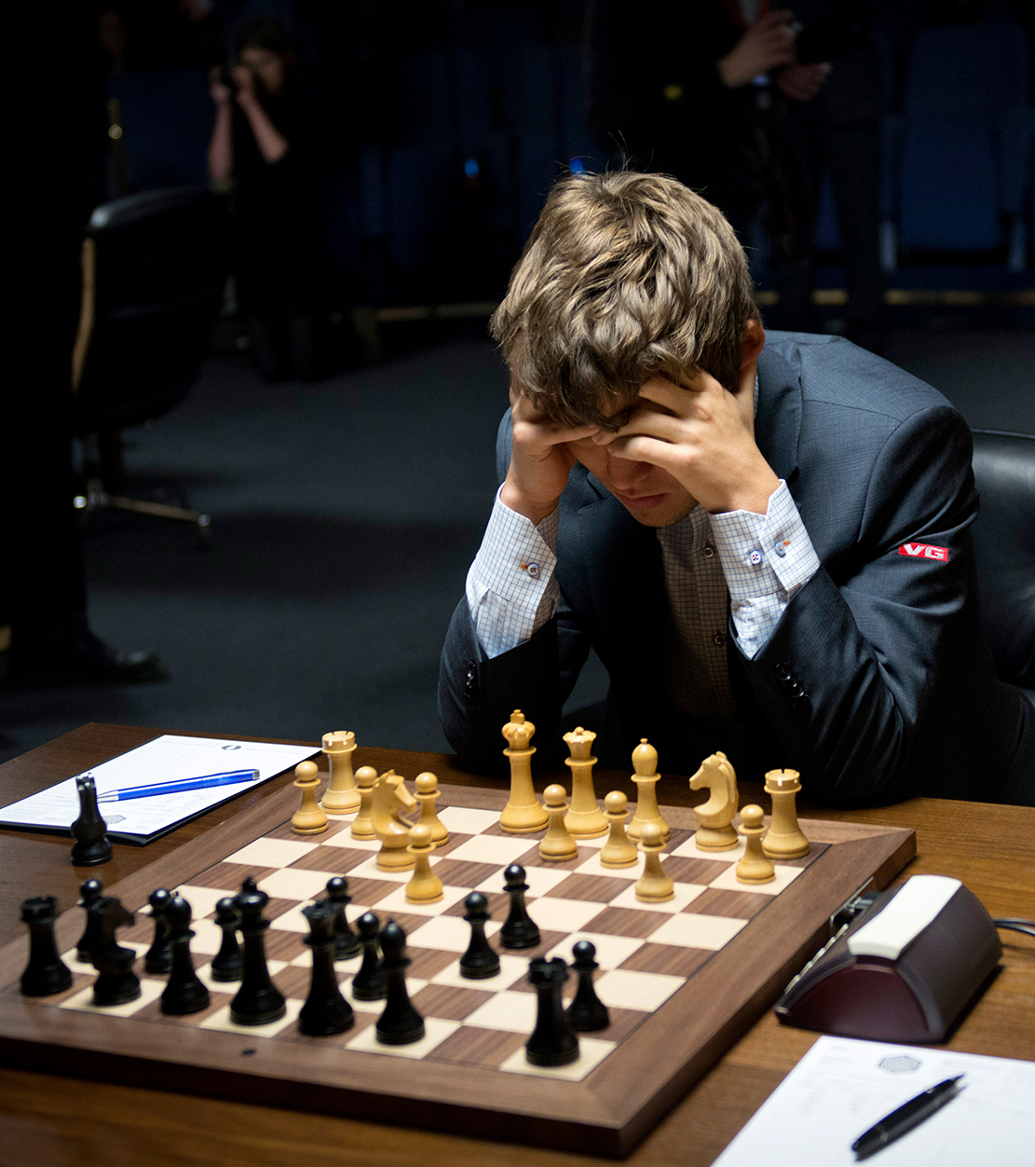
Objectives
Create an application that allows two users to play chess
Have a player play against the computer (offline game)
Make the game visually user friendly and effective
Create a complete GUI of a chess board and representation of pieces with their proper movements.
Have all group members test and calibrate the system to make sure it is working properly
Give live presentation of the finished chess game
Organization:
Riyan: Board class
Zach: HTML
Logan: Game initialization
Ian: Player representation
Sheeka: Verification and validation
Carmen: Pieces class

Slide 6
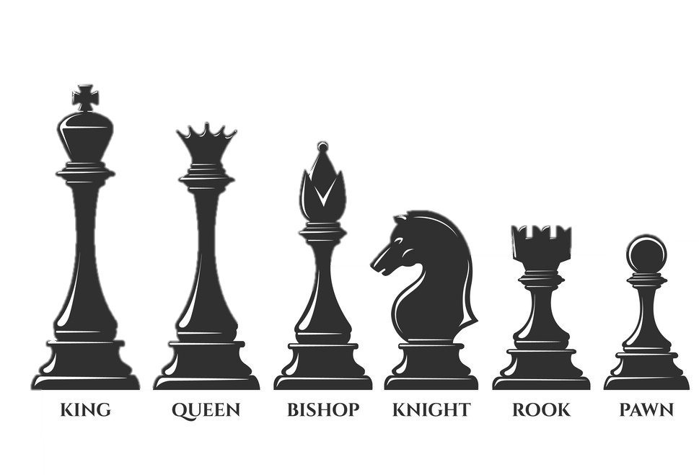
Methodology - Design Specification
Board Representation:
The chess board will be represented as an 8x8 grid of squares with alternating black and white squares.
Each square will contain a piece, which will be represented using standard algebraic notation.
Pieces Representation: Each piece on the board will be represented by a class with specific attributes and functions. The pieces will include:
King
Queen
Rook
Bishop
Knight
Pawn
Player Representation:
Each player will be represented by a class that includes their name and color (black or white).
Game Initialization:
The game will start by initializing the board with the pieces in their starting positions, setting the current player to white, and setting the game state to active.
Piece Movement:
Each piece will have a set of rules for how it can move across the board. These rules will be programmed into the class for each piece.

Slide 7
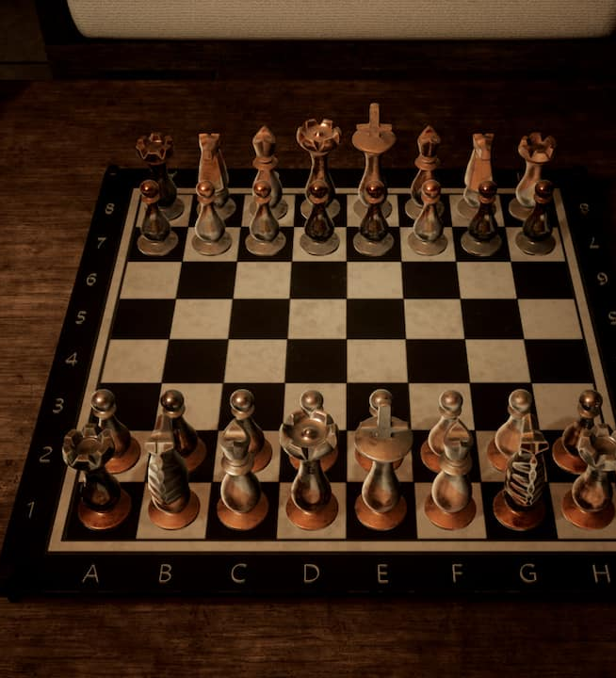
Methodology- Design Specification 2
Capturing Pieces:
When a player's piece lands on a square occupied by an opponent's piece, the opponent's piece will be removed from the board.
Check and Checkmate:
The game will detect when a player's king is in check, and will not allow the player to make a move that leaves their king in check. The game will also detect when a player's king is in checkmate, ending the game.
Game Loop:
The game will loop until one of the players has won or the game has ended in a draw
Experimental Details:
To test the functionality of the game, we can write a test script that will simulate a game between two players. We can also create a GUI to display the board and allow the user to interact with the game

Slide 8
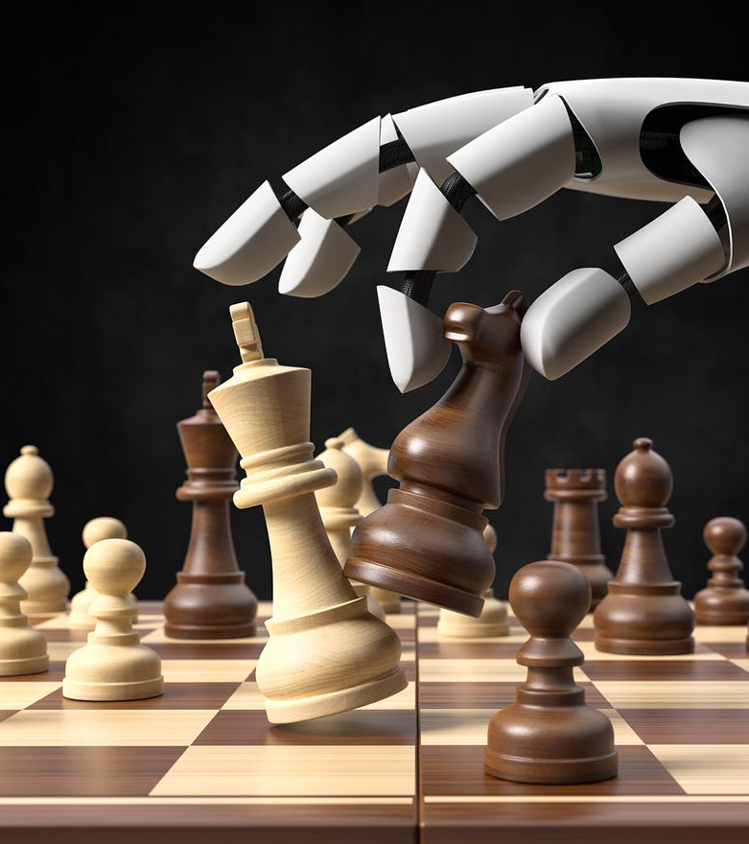
System Architecture
Model and Algorithm Structures:
Board: A two-dimensional array to represent the board
Piece: A base class for all the pieces on the board
King, Queen, Rook, Bishop, Knight, Pawn: Subclasses of Piece with specific movement rules
Player: A class to represent the player with name and color properties
Game: A class to manage the game flow, including initializing the board and players, validating moves, detecting check/checkmate, and ending the game
Project Outcomes and Deliverables:
The deliverables will include the Python code, any necessary libraries or dependencies, and any documentation or instructions for running the game. This project will provide a good exercise in object-oriented programming, data structures, and algorithm design.

Slide 9
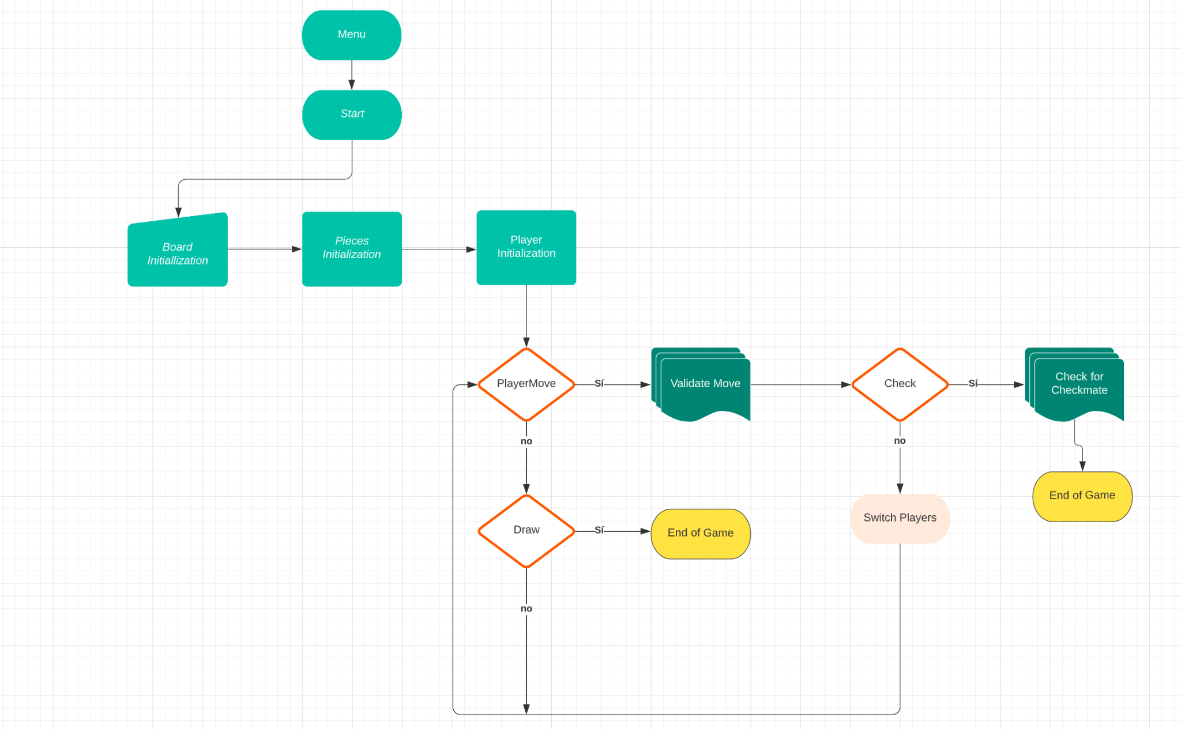
System Architecture - Flowchart

Slide 10
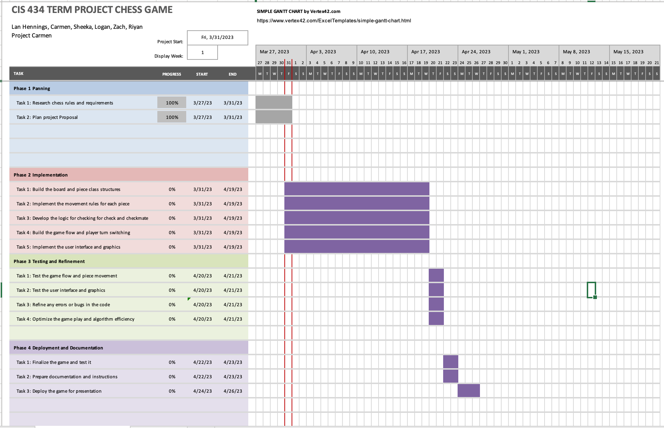
Project Timeline refer to slide 10
Notes:
Phase 1: Planning and Design
Task 1: Research the rules and requirements of a chess game (3 days)
Task 2: Plan the project Proposal (3 days)
Phase 2: Implementation
Task 1: Build the board and piece class structures (20 days)
Task 2: Implement the movement rules for each piece (20 days)
Task 3: Develop the logic for checking for check and checkmate (20 days)
Task 4: Build the game flow and player turn switching (20 days)
Task 5: Implement the user interface and graphics (20 days)
Phase 3: Testing and Refinement
Task 1: Test the game flow and piece movements (2 days)
Task 2: Test the user interface and graphics (2 days)
Task 3: Refine any errors or bugs in the code (2 days)
Task 4: Optimize the game play and algorithm efficiency (2 days)
Phase 4: Deployment and Documentation
Task 1: Finalize the game and test it thoroughly (2 days)
Task 2: Prepare documentation and instructions for using the game (2 days)
Task 4: Deploy the game for presentation (1 day)
Total estimated time: 31 days

Slide 11
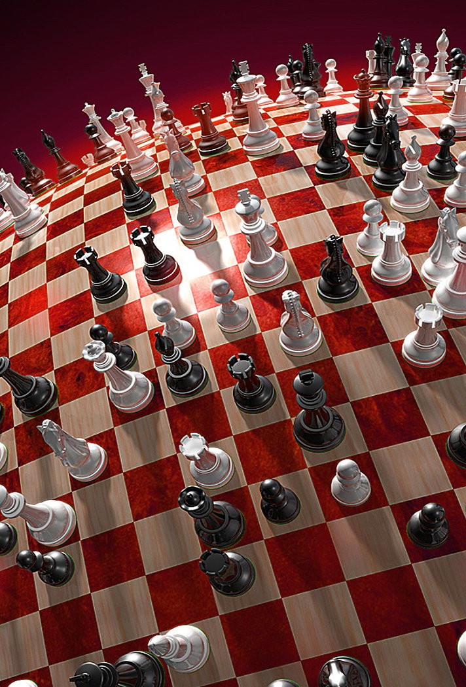
Conclusion
Project Outcomes and Conclusions:
The outcome of this project will be a fully functional chess game written in Python. The game will allow for two players to make moves on a graphical user interface, and will have logic for checking the validity of moves, detecting check and checkmate, and determining the winner of the game.

Slide 12

END

